Slide 1
INVESTMENT CASE STUDY SUBMISSION
Group Name:
Ravi Biradar
Tanmaya Ray
Ashish Hota
SivaRamaKrishnaReddy. V

Slide 2
Abstract
In this present project, we work for Spark Funds an asset management company. Spark Funds wants to make investment in a few English speaking countries between 5 to 15 million USD per round of investment. To take the investment decision effectively, Spark Funds is to identify the best sectors, countries and suitable investment type where other investors are investing. As part of the analysis, we have done Investment type analysis to identify the best funding type, Country analysis to choose the best country which has been invested heavily in the past and Sector analysis to pinpoint the finest sectors for distribution of investments across eight main sectors. For doing analysis and visualization we use PYTHON and TABLEAU respectively.

Slide 3
Flow Chart
start
Input: Reading companies.txt and rounds2.csv files
Merge Data Frames companies to rounds2 and create master_frame
(Check Point – 1)
Merge Data Frames
master_frame and mapping & create final_df
Output: Sector wise investment analysis -2 of D1, D2 and D3 Data Frames
(Check Point – 5)
Cleaning and Analysis of master_frame Data Frame
Output: Sector Analysis-1 &
determining the main sector
(Check Point – 4)
Output: Investment type Analysis & Identify the best funding type
(Check Point – 2)
Output: Country Analysis & Identify Top 3 English Speaking Countries (Check Point – 3)
Input: Reading mapping.csv file
Output: Plots
(Check Point – 6)

Slide 4
Investment Type Analysis
Spark Funds wants to choose one of the four investment types Seed, Angel, Venture and Private equity whose average values of investments between 5 to 15 million USD.
We have calculated the average values of investments for each of four funding types from the master_frame data frame
Clearly, from the Table-1, Venture Funding Type shows 11.73 million USD which falls under 5 to 15 million USD and is the most suitable funding type where Spark Funds can invest.
Funding Type | Average Funding Amount (million USD)
Seed | 0.75
Angel | 0.97
Venture | 11.73
Private Equity | 73.93
Table 1: Average values of Investments for each of Funding Types

Slide 5
Country Analysis
Spark Funds wants to invest in countries with the highest amount of funding for the chosen investment type Venture.
For the chosen investment type Venture We have identified top 9 countries based on the total investment amount each country has received.
As Spark Funds has a constraint to invest only in English-speaking countries, we select first three English-speaking countries among the top 9 countries.
Funding Type | Average Funding Amount (million USD)
Top English Speaking Country | USA (United State of America)
Second English Speaking Country | GBR (Great Britain)
Third English Speaking Country | IND (India)
Table 2: Top 3 English Speaking Countries

Slide 6
Sector Analysis
In Sector Analysis, the main objective is to achieve Spark Funds invest in eight of one sectors listed in the mapping.csv file where maximum number of people are investing.
The category_list column in master_frame DF, has multiple sub-sectors separated by a pipe ( vertical bar | ) and the first string before the vertical bar will be considered as primary_sector.
category _list | primary_sector
Application Platforms | Real Time | Social Network Media | Application Platforms
From the above table Application Platforms will be considered as primary_sector
We have extracted each the primary_sector of each category list from the category_list column
Then we have merged mapping.csv file to map each primary_sector of master_frame DF to on of the eight main sectors

Slide 7
Sector Analysis
Now we know that the top three English-speaking countries (USA, GBR and IND) and the most suitable funding type (Venture) for Spark Funds.
Our aim is to find out the most heavily invested main sectors in each of the three countries for Venture funding type and investment range of 5 – 15 million USD.
For this we have created three data frames D1, D2 and D3 for each of the three countries containing the observations of Venture funding type falling within the 5 – 15 million USD range.

Slide 8
Sector Analysis
 | USA | GBR | IND
1. Total Number of Investments | 37996 | 2265 | 982
2. Total amount of investment | 444377974114.21 | 22700168685.37 | 16173379146.85
3. Top Sector | Others | Others | Others
4. Second-best Sector | Cleantech/Semiconductors | Social, Finance, Analytics, Advertising | Social, Finance, Analytics, Advertising
5. Third-best Sector | Social, Finance, Analytics, Advertising | Cleantech/Semiconductors | News, Search and Messaging
6. Number of Investments in the Top Sectors | 8772 | 581 | 332
7. Number of Investment in the Second-best Sector | 8263 | 481 | 193
8. Number of Investment in the Third-best Sector | 7811 | 466 | 154
9. For the Top count-wise, which company received the highest investment? | SoFi | OneWeb | Flipkart
10. For the second-best sector count-wise, which company received the highest investment? | Freescale Semiconductor | Mereo | ShopClues.com
Table 3: Sector-wise Investment Analysis

Slide 9
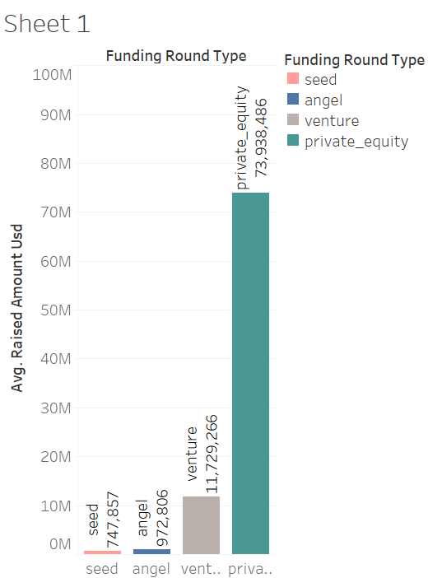
Investment Type Analysis
Plot 1: Investment type and Avg. raised amount USD

Slide 10
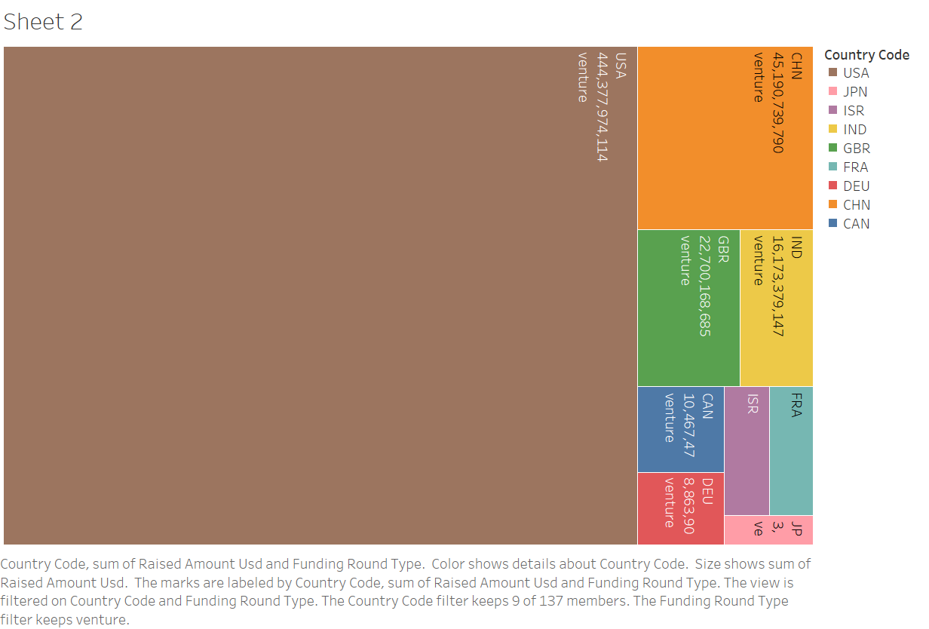
Country Analysis
Plot 2: Country wise raised amount USD in venture funding type

Slide 11
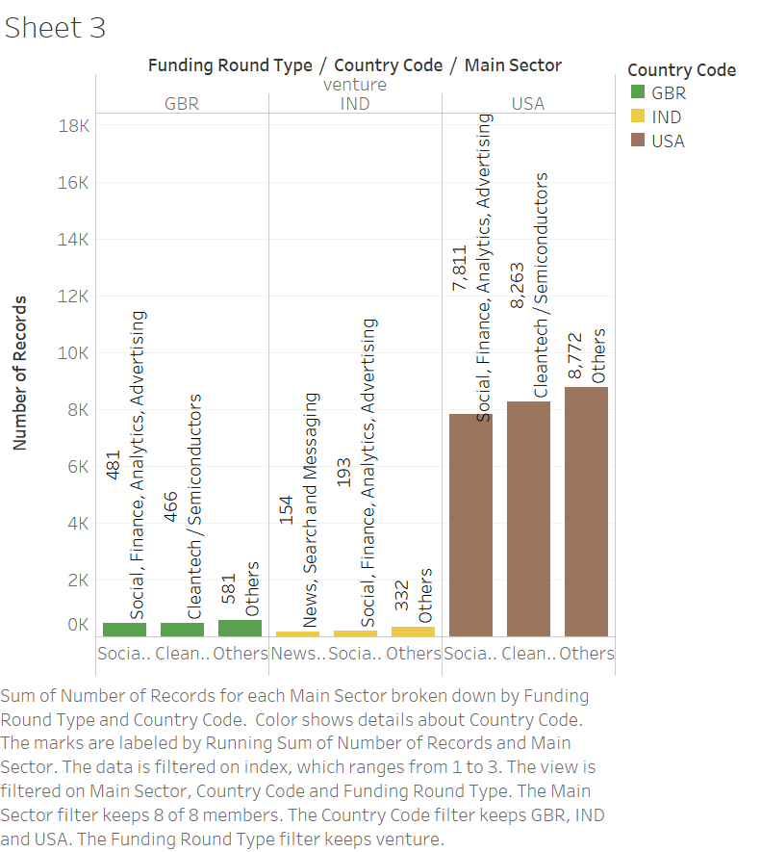
Sector Analysis
Plot 3: Sector wise investment of each country USA, GBR and IND

Slide 12
Conclusion
For the investment type, Spark Funds should invest in venture funding as they only want to invest in between 5-15 million.
Spark funds can invest in United states of America, Great Britain and India for the venture funding type as they are the top 3 English speaking countries with the highest investment.
We choose the Others Sector for all the 3 countries and venture funding type to invest in. As it has highest number of investments in all the 3 countries.

